Slide 1
Requirement Modeling : Behavior Patterns and Web/Mobile Apps
Session 08
Course : Software Engineering
Effective Period : Desember 2017

Slide 2
These slides have been adapted from
Pressman, R.S. (2015). Software Engineering : A Practioner's Approach. 8th ed. McGraw-Hill Companies.Inc, Americas, New York. ISBN : 978 1 259 253157. Chapter 11
Acknowledgement

Slide 3
LO 2 : Explain the software engineering practices and business environment
Learning Objectives

Slide 4
Contents
Creating Behavioral Models
Identifying Event with the Use Case
State Representations
Patterns for Requirements Modeling
Requirements Modeling for Web and Mobile Apps

Slide 5
Creating A Behavioral Model
The behavioral model indicates how software will respond to external events or stimuli.
To create the model, you should perform the following steps :
Evaluate all use cases to fully understand the sequence of interaction within the system
Identify events that drive the interaction sequence and understand how these events relate to specific objects.
Create a sequence for each use case.
Build a state diagram for the system, and
Review the behavioral model to verify accuracy and consistency

Slide 6
Identifying Events with
the Use Case
In general, an event occurs whenever the system and an actor exchange information.
An event is not the information that has been changed, but rather the fact that information exchange

Slide 7
State Representations
In the context of behavioral modeling, two different characterizations of states must be considered:
  the state of each class as the system performs its function and
  the state of the system as observed from the outside as the system performs its function
The state of a class takes on both passive and active characteristics [CHA93].
  A passive state is simply the current status of all of an object’s attributes.
  The active state of an object indicates the current status of the object as it undergoes a continuing transformation or processing.

Slide 8
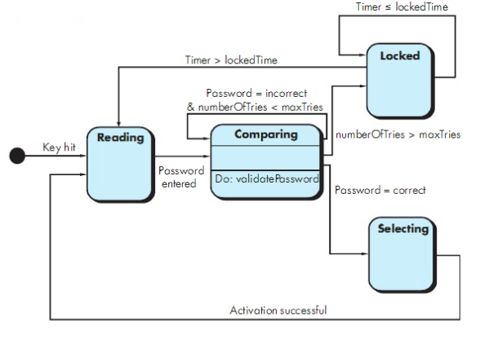
State Representations
State diagram for the ControlPanel class

Slide 9
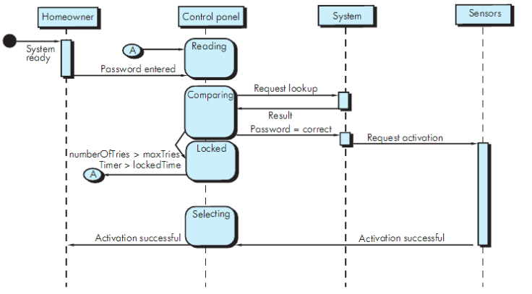
State Representations
Sequence diagram (partial) for the SafeHome security function

Slide 10
Patterns for Requirement Modeling
  Pattern name: A descriptor that captures the essence of the pattern.
  Intent: Describes what the pattern accomplishes or represents
  Motivation: A scenario that illustrates how the pattern can be used to address the problem.
  Forces and context: A description of external issues (forces) that can affect how the pattern is used and also the external issues that will be resolved when the pattern is applied.
  Solution: A description of how the pattern is applied to solve the problem with an emphasis on structural and behavioral issues.
  Consequences: Addresses what happens when the pattern is applied and what trade-offs exist during its application.
  Design: Discusses how the analysis pattern can be achieved through the use of known design patterns.
  Known uses: Examples of uses within actual systems.
  Related patterns: On e or more analysis patterns that are related to the named pattern because (1) it is commonly used with the named pattern; (2) it is structurally similar to the named pattern; (3) it is a variation of the named pattern.

Slide 11
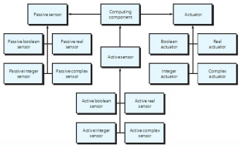
Patterns for Requirement Modeling
UML sequence diagram for the Actuator-Sensor pattern

Slide 12
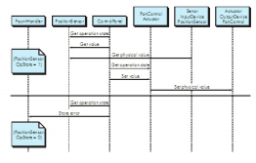
Patterns for Requirement Modeling
UML Class diagram for the Actuator-Sensor pattern

Slide 13
When Do We Perform Analysis?
Requirement Modeling
for Web and Mobile Apps
In some WebE situations, analysis and design merge. However, an explicit analysis activity occurs when …
  the WebApp to be built is large and/or complex
  the number of stakeholders is large
  the number of Web engineers and other contributors is large
  the goals and objectives (determined during formulation) for the WebApp will effect the business’ bottom line
  the success of the WebApp will have a strong bearing on the success of the business

Slide 14
The Content Model
Requirement Modeling
for Web and Mobile Apps
Content objects are extracted from use-cases
  examine the scenario description for direct and indirect references to content
Attributes of each content object are identified
The relationships among content objects and/or the hierarchy of content maintained by a WebApp
  Relationships—entity-relationship diagram or UML
  Hierarchy—data tree or UML

Slide 15
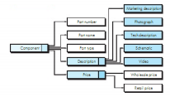
Data Tree for www.safehomemeassured.com component
Requirement Modeling
for Web and Mobile Apps

Slide 16
The Interaction Model
Requirement Modeling
for Web and Mobile Apps
Composed of four elements:
  use-cases
  sequence diagrams
  state diagrams
  a user interface prototype

Slide 17
The Functional Model
Requirement Modeling
for Web and Mobile Apps
The functional model addresses two processing elements of the WebApp
  user observable functionality that is delivered by the WebApp to end-users
  the operations contained within analysis classes that implement behaviors associated with the class.
An activity diagram can be used to represent processing flow

Slide 18
The Configuration Model
Requirement Modeling
for Web and Mobile Apps
Server-side
  Server hardware and operating system environment must be specified
  Interoperability considerations on the server-side must be considered
  Appropriate interfaces, communication protocols and related collaborative information must be specified
Client-side
  Browser configuration issues must be identified
  Testing requirements should be defined

Slide 19
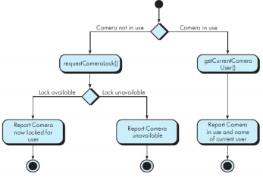
Activity diagram for the takeControlOfCamera() Operation
Requirement Modeling
for Web and Mobile Apps

Slide 20
References
Pressman, R.S. (2015). Software Engineering : A Practioner's Approach. 8th ed. McGraw-Hill Companies.Inc, Americas, New York. ISBN : 978 1 259 253157.
Introduction to Model-View-View-Model (MVVM) Pattern, http://www.youtube.com/watch?v=pY60lLotZCg
Modeling Web Apps http://islab.kaist.ac.kr/Lecture/wst500_2012_Spring/pdf/Modeling_Web_Applications.pdf
Modeling the Mobile Application Development Lifecycle, http://www.iaeng.org/publication/IMECS2014/IMECS2014_pp596-600.pdf

Slide 21
Q & A

